Slide 1
AI and Music: Technology, Creativity, and the Future of Art
Presenter: Yuyi Yang, MB, MPH, PhD Student

Slide 2
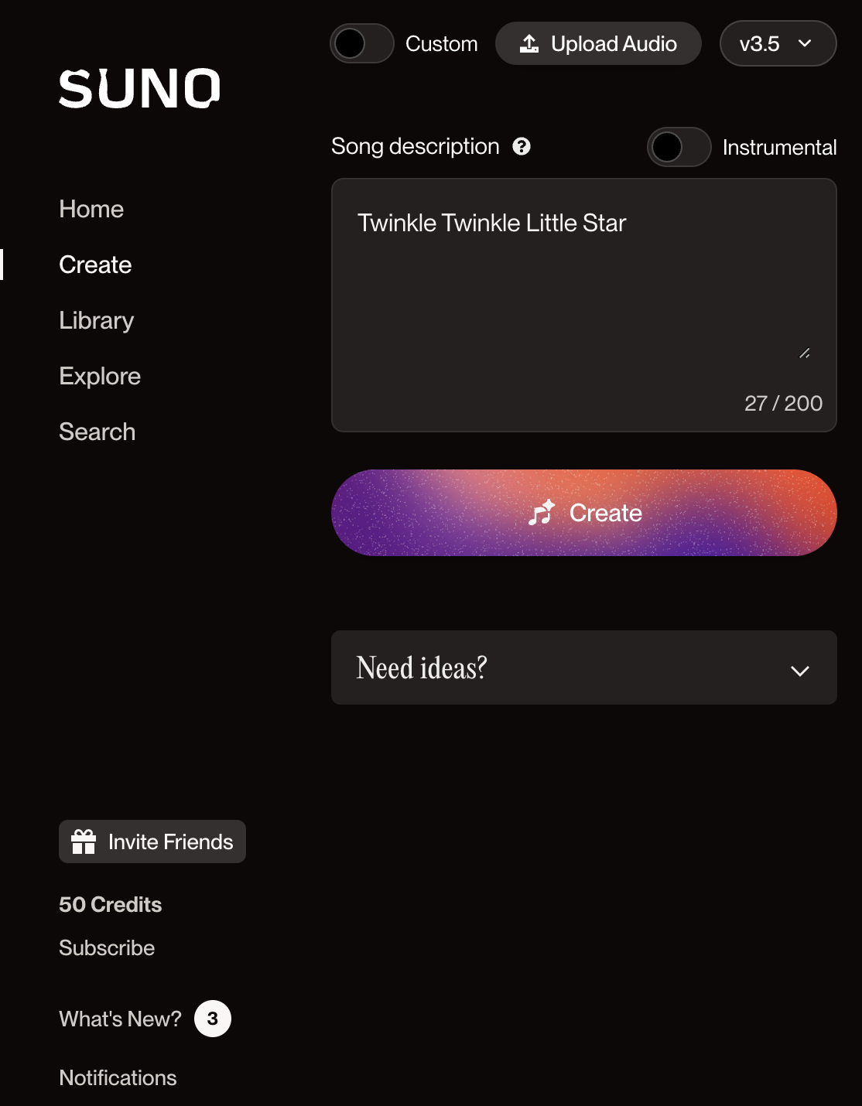
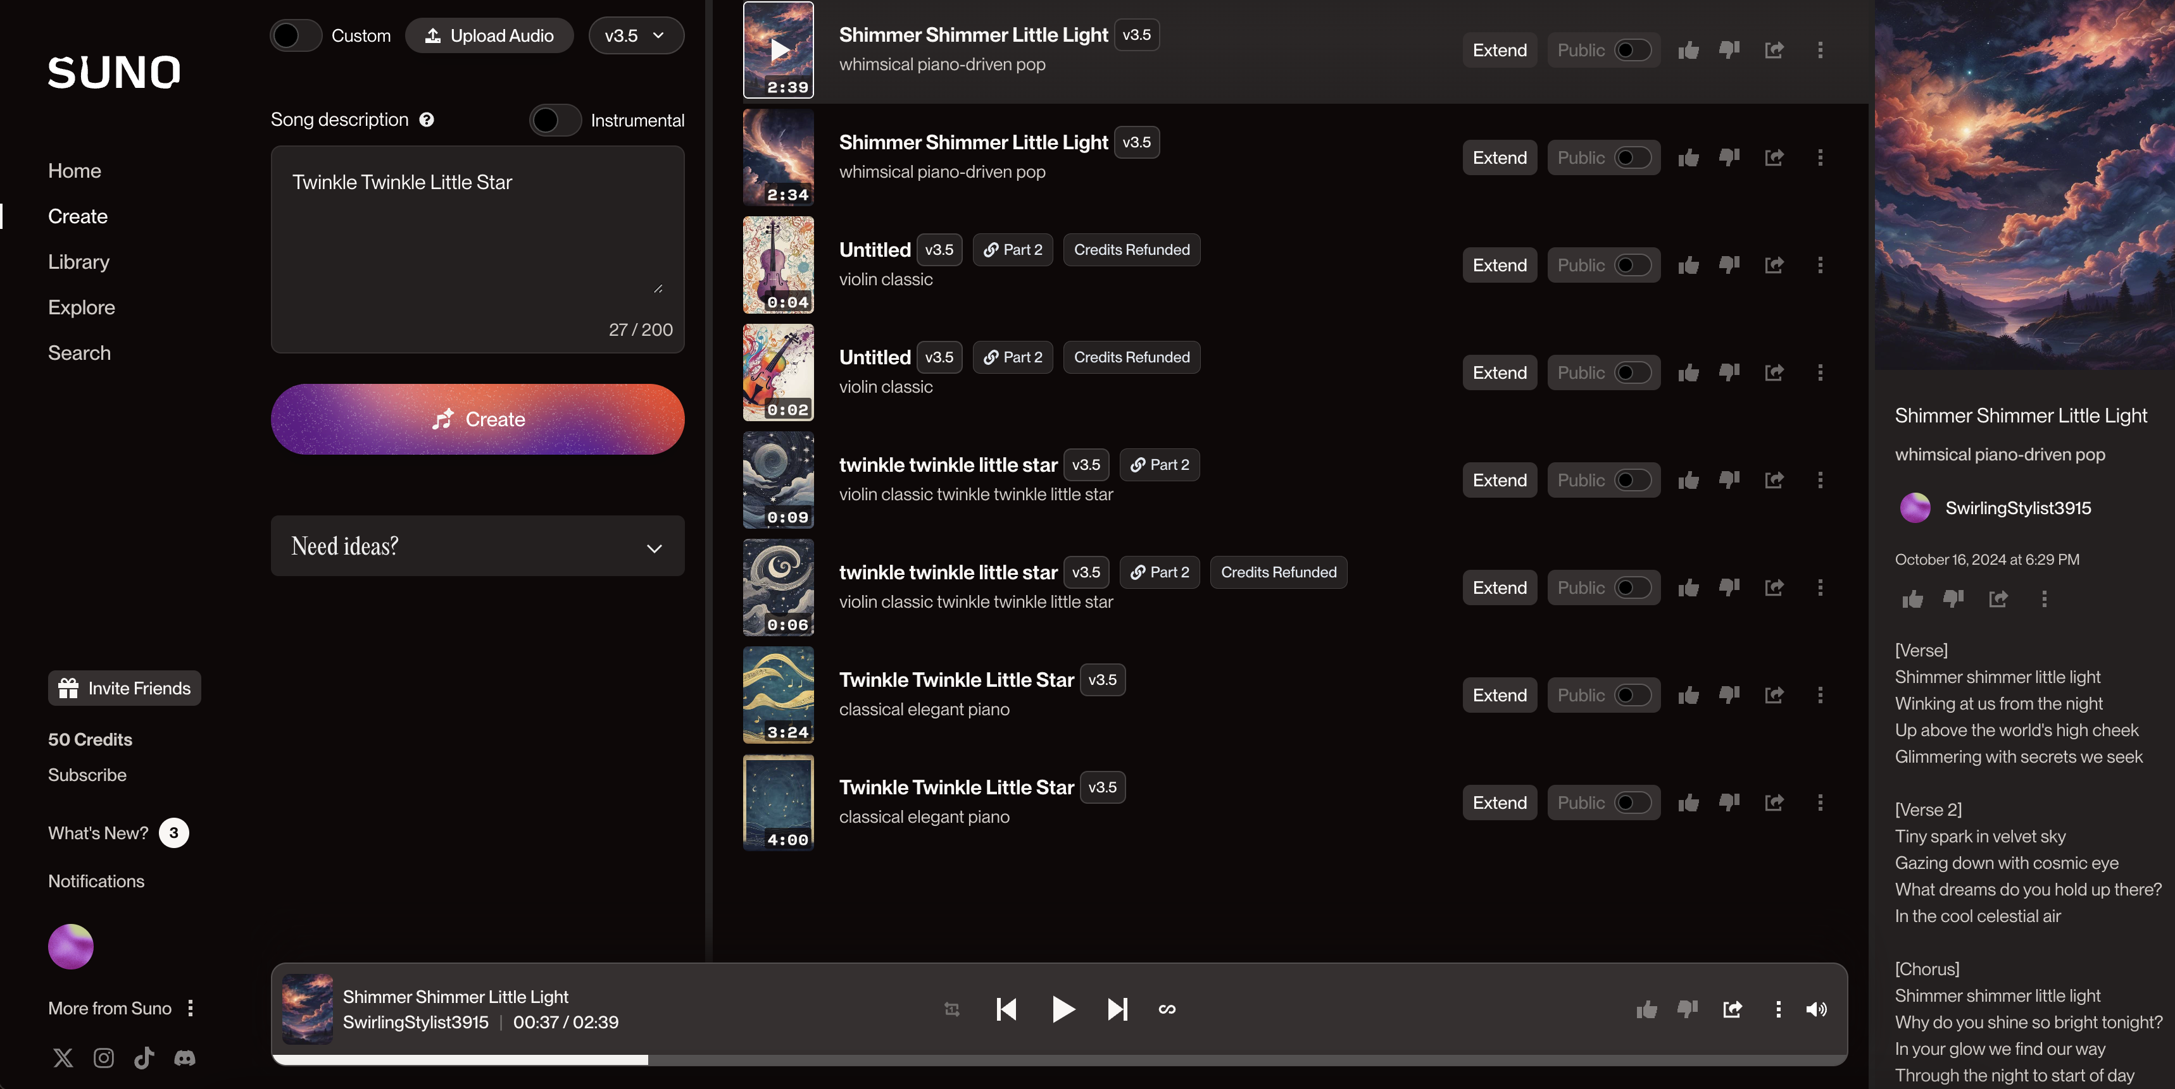

Example: AI-Generated Composition with SUNO

Slide 3
Traditional vs. AI Music Composition
💡
Inspiration
🎼
Composition
🎙️
Recording
TRADITIONAL
🎚️
Mixing
And
Production
✍️ 🎹
Lyrics
And
Arrangement
🎧
Data
🔄
Optimization
🧠
Model Training
AI

Slide 4
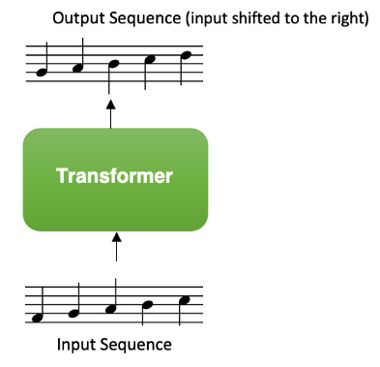
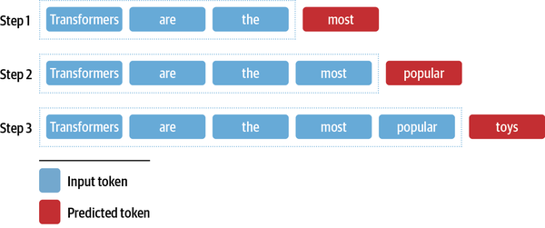
Transformers and Diffusion Models in AI Composition
Transformers:
Predict the next element (note) based on prior context
Maintain long-range coherence

Slide 5

Transformers and Diffusion Models in AI Composition
Diffusion Models:
Start with noise, refined over steps to create structured output (waveform).
Efficient at capturing audio details

Slide 6
Advantages of AI in Music Composition
Lower Barrier
Spark Creativity for Musicians
New Music Styles Beyond Human Imagination
Original, Copyright-Free Music
AI Isn’t Only Reshaping Music!
Mastering AI Now Will Set Us Apart As Leaders In The Next Wave Of Innovation.

Slide 7
Limitations of AI in Music
Lack of Emotion
Homogenization (train on similar datasets)
Ethical Concerns (train on copyrighted music)
Lack Unique, Original Vision
Great music is more than notes and rhythms;
It’s a reflection of the artist's soul and life story.

Slide 8
Discussion (Q&A)
How Does AI Address Its Lack of Emotional Depth?
Will AI-Generated Music Lead to Unemployment for Human Musicians?
Can AI-generated music be considered art?

